Slide 1
Data Structure & Algorithms
Lecture 6
Linked List

Slide 2
Definition - List
A list is a collection of items that has a particular order
  It can have an arbitrary length
  Objects / elements can be inserted or removed at arbitrary locations in the list
  A list can be traversed in order one item at a time

Slide 3
List Overview
Linked lists
  Abstract data type (ADT)
Basic operations of linked lists
  Insert, find, delete, print, etc.
Variations of linked lists
  Singly linked lists
  Circular linked lists
  Doubly linked lists
  Circular doubly linked list

Slide 4
Linked List Terminologies
Traversal of List
  Means to visit every element or node in the list beginning from first to last.
Predecessor and Successor
  In the list of elements, for any location n, (n-1) is predecessor and (n+1) is successor.
  In other words, for any location n in the list, the left element is predecessor and the right element is successor.
  Also, the first element does not have predecessor and the last element does not have successor.

Slide 5
Linked Lists
A
B
C
∅
Head
A linked list is a series of connected nodes
Each node contains at least
  A piece of data (any type)
  Pointer to the next node in the list
Head: pointer to the first node
The last node points to NULL
node
A
data
pointer

Slide 6
Lists – Another perspective
A list is a linear collection of varying length of homogeneous components.
Homogeneous: All components are of the same type.
Linear: Components are ordered in a line (hence called Linear linked lists).
Arrays are lists..

Slide 7
Arrays Vs Lists
Arrays are lists that have a fixed size in memory.
The programmer must keep track of the length of the array
No matter how many elements of the array are used in a program, the array has the same amount of allocated space.
Array elements are stored in successive memory locations. Also, order of elements stored in array is same logically and physically.

Slide 8
Arrays Vs Lists
A linked list takes up only as much space in memory as is needed for the length of the list.
The list expands or contracts as you add or delete elements.
In linked list the elements are not stored in successive memory location
Elements can be added to (or deleted from) either end, or added to (or deleted from)the middle of the list.

Slide 9
Array versus Linked Lists
Linked lists are more complex to code and manage than arrays, but they have some distinct advantages.
  Dynamic: a linked list can easily grow and shrink in size.
    We don’t need to know how many nodes will be in the list. They are created in memory as needed.
    In contrast, the size of a C++ array is fixed at compilation time.
  Easy and fast insertions and deletions
    To insert or delete an element in an array, we need to copy to temporary variables to make room for new elements or close the gap caused by deleted elements.
    With a linked list, no need to move other nodes. Only need to reset some pointers.

Slide 10
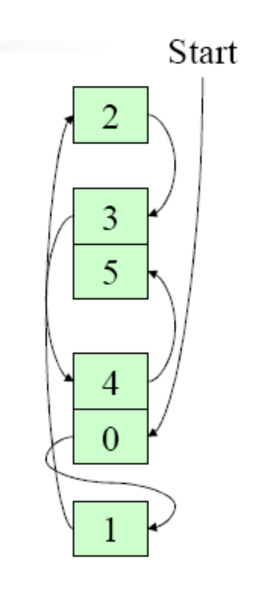
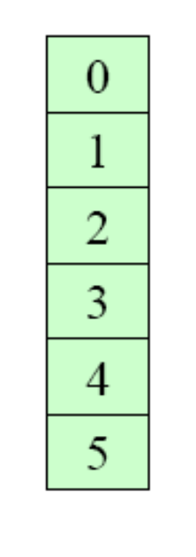
An Array
A Linked List

Slide 11
Basic Operations of Linked List
Operations of Linked List
  IsEmpty: determine whether or not the list is empty
  InsertNode: insert a new node at a particular position
  FindNode: find a node with a given value
  DeleteNode: delete a node with a given value
  DisplayList: print all the nodes in the list

Slide 12
An integer linked list
First Node of List
Last Node of List
list
10
13
5
2
data
next
NULL

Slide 13
Creating a List node
struct Node {
int data; // data in node
Node *next; // Pointer to next node
};
Node *p;
p = new Node;
p - > data = 10;
p - > next = NULL;
p
10

Slide 14
The NULL pointer
NULL is a special pointer value that does not reference any memory cell.
If a pointer is not currently in use, it should be set to NULL so that one can determine that it is not pointing to a valid address:
int *p;
p = NULL;

Slide 15
Adding a node to a list
Node *p, *q;
p = new Node;
p - > data = 10;
p - > next = NULL;
q = new Node;
q - > data = 6;
q - > next = NULL;
p - > next = q;
p
10
q
6
p
10
6
q

Slide 16
Accessing List Data
Node 1
Node 2
p
10
6
Expression
p
p - > data
p - > next
p - > next - > data
p - > next - > next
Value
Pointer to first node (head)
10
Pointer to next node
6
NULL pointer

Slide 17
Using typedef with pointers
struct Node {
int data; // data in node
Node *next; // Pointer to next node
};
typedef Node *NodePtr; // NodePtr type is a pointer
// to a Node
Node *p; // p is a pointer to a Node
NodePtr q; // q is a pointer to a Node

Slide 18
Building a list from 1 to n
struct Node {
int data;
Node *next;
};
Node *head = NULL; // pointer to the list head
Node *lastNodePtr = NULL; // pointer to last node in list
head
lastNodePtr

Slide 19
Creating the first node
Node *ptr; // declare a pointer to Node
ptr = new Node; // create a new Node
ptr - > data = 1;
ptr - > next = NULL;
head = ptr; // new node is first
lastNodePtr = ptr; // and last node in list
head
1
ptr
lastNodePtr

Slide 20
Adding more nodes
for (int i = 2; i < = n; i ++ ) {
ptr = new Node; //create new node
ptr - > data = i;
ptr - > next = NULL;
lastNodePtr - > next = ptr; // order is
lastNodePtr = ptr; // important
}
head
1
2
ptr
lastNodePtr

Slide 21
Initially
head
1
2
ptr
lastNodePtr
head
1
2
lastNodePtr
ptr
3
Create a new node with data field set to 3
Its next pointer should point to NULL

Slide 22
head
1
2
ptr
lastNodePtr
head
1
2
lastNodePtr
ptr
3
The next pointer of the node which was previously last should now point to newly created node “lastNodePtr->next=ptr”

Slide 23
head
1
2
ptr
lastNodePtr
head
1
2
lastNodePtr
ptr
3
The next pointer of the node which was previously last should now point to newly created node “lastNodePtr->next=ptr”
LastNodePtr should now point to the newly created Node “lastNodePtr = ptr;”

Slide 24
head
1
2
ptr
lastNodePtr
head
1
2
lastNodePtr
ptr
3
LastNodePtr should now point to the newly created Node “lastNodePtr = ptr;”

Slide 25
Re-arranging the view
head
1
2
3
ptr
lastNodePtr

Slide 26
Inserting a node in a list
head
2
5
8
prevNode
currNode
6
?
ptr
Step 1: Determine where you want to insert a node.
Step 2: Create a new node:
Node *ptr;
ptr = new Node;
ptr - > data = 6;

Slide 27
Node *ptr, *currNode, *prevNode ;
prevNode = head;
ptr = new Node;
ptr->data = 6;
ptr->next = NULL;
currNode = head->next;
While (currNode->data < ptr->data)
{
prevNode = currNode;
currNode = currNode->next;
}
Note:
when this loop terminates prevNode and currNode are at a place where insertion will take place. Only the “LINKS” or pointers of the list remain to be adjusted

Slide 28
Continuing the insert
Step 3: Make the new node point to the current Node pointer.
ptr - > next = currNode;
Step 4: Make previous node point to the new node:
prevNode - > next = ptr;
head
2
5
8
6
prevNode
ptr
currNode
Now The new link has been added in the linked list

Slide 29
Deleting a node from a list
head
2
5
8
prevNode
delNode
Step 1: Redirect pointer from the Node before the one to be deleted to point to the Node after the one to be deleted.
prevNode - > next = delNode - > next;
head
2
5
8
prevNode
delNode

Slide 30
Finishing the deletion
Step 2: Remove the pointer from the deleted link.
delNode - > next = NULL;
head
2
5
8
prevNodePtr
delNode
Step 3: Free up the memory used for the deleted node:
delete delNode;

Slide 31
List Operations - Summarized

Slide 32
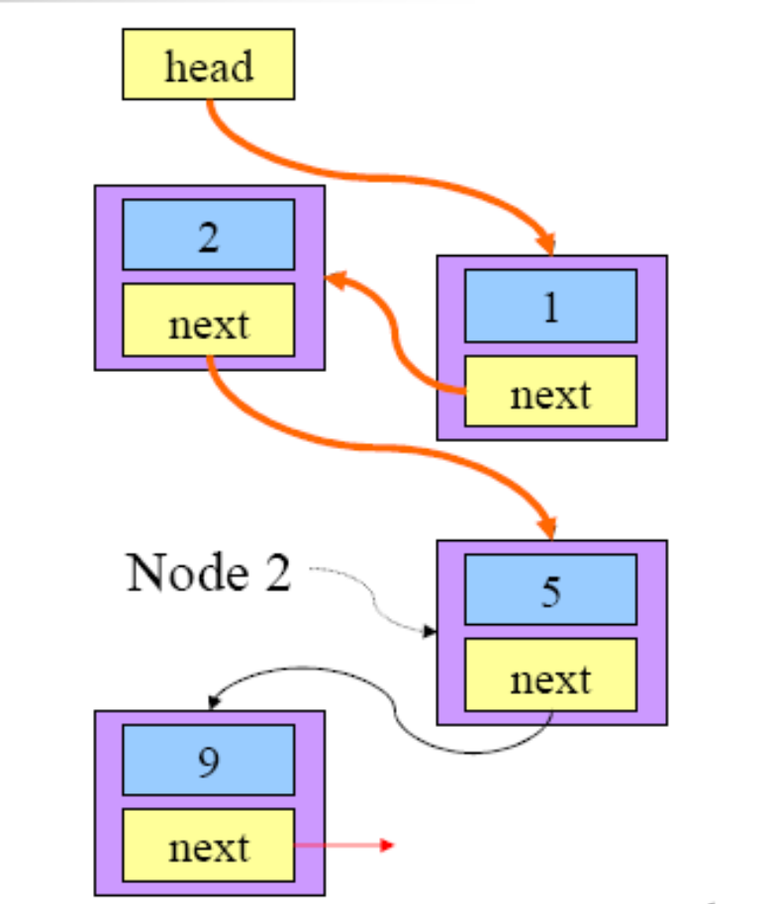
Traversing a Linked List

Slide 33
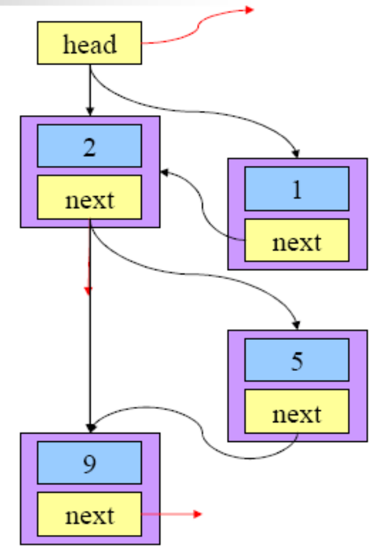
Insertion in a Linked List

Slide 34
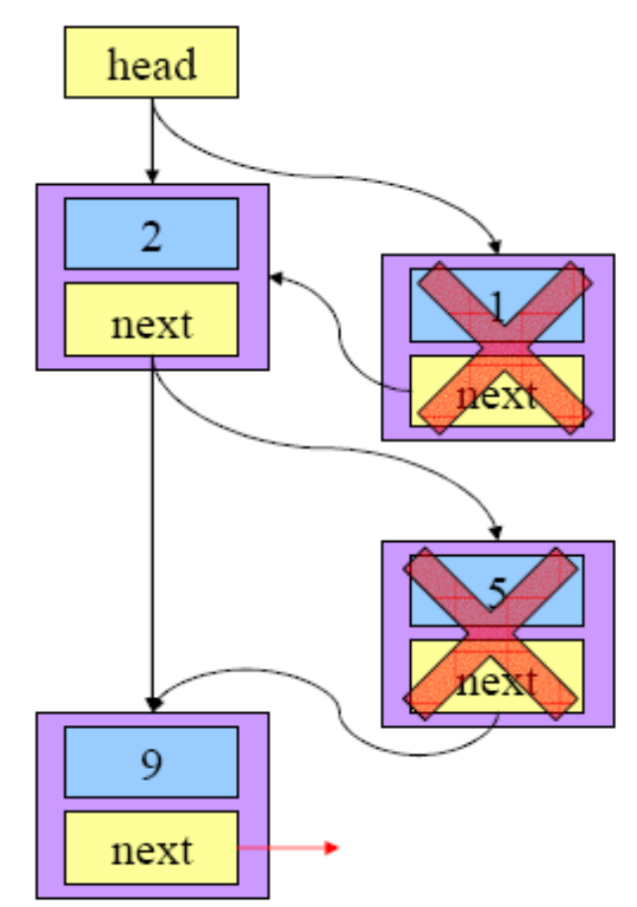
Deletion from a Linked List

